Slide 1

NIKHIL T Y. Student ID: STU64572ba8172351683434408 Internship ID: INTERNSHIP_168198413964410a8b547b1 21bcaa42@kristujayanti.com Kristu Jayanti college. Bangalore, Karnataka.
Cyber Security (CS)
12-06-2023 to 24-07-2023

Slide 2
Problem Statement : -
Develop a keylogger software as a cybersecurity project that can monitor and record keystrokes on a target system while ensuring user privacy and data security.
Description:
A keylogger is a cybersecurity tool that can play a vital role in detecting and preventing potential threats to user privacy and data security. By silently capturing and recording keystrokes made on a target system, a keylogger can provide valuable insights into user activities, helping to identify unauthorized access attempts, potential security breaches, and suspicious behavior. With advanced encryption techniques and robust privacy measures, a well-designed keylogger can ensure that the captured keystrokes are securely stored and accessible only to authorized individuals. By operating in a stealthy manner and offering comprehensive reporting and analysis capabilities, a keylogger serves as a powerful defensive tool in the fight against cyber threats, strengthening the overall security posture of individuals and organizations.

Slide 3
AGENDA
Research and Understanding:
a.) Conduct thorough research on keyloggers, their functionality, and different types of keylogging attacks.
b.) Gain a comprehensive understanding of the potential risks and vulnerabilities associated with keylogging activities.
Requirements Gathering:
a.) Identify and document the specific requirements and objectives of the keylogger software.
b.) Consult with cybersecurity experts and stakeholders to ensure all necessary features and functionalities are included.
Design and Architecture:
a.) Develop a detailed design and architecture plan for the keylogger software.
b.) Define the system components, data flow, encryption mechanisms, and detection algorithms to be implemented.
Implementation:
a.) Begin the development of the keylogger software based on the defined design and architecture.
b.) Implement the keylogging functionality, encryption techniques, detection mechanisms, and reporting features.

Slide 4
Testing and Quality Assurance: a. Conduct rigorous testing to ensure the keylogger software functions as intended. b. Perform security testing to identify and fix any vulnerabilities or weaknesses in the system. c. Ensure compliance with relevant cybersecurity standards and best practices.
Privacy and Legal Considerations: a. Address privacy concerns by implementing strong encryption and access controls for the captured keystrokes. b. Ensure compliance with applicable laws and regulations related to keylogger usage and data privacy.
User Interface and User Experience: a. Design and develop a user-friendly interface for the keylogger software. b. Ensure the software is intuitive, easy to navigate, and provides clear reporting and analysis capabilities.
Documentation: a. Create comprehensive documentation that includes installation instructions, user guides, and system specifications. b. Document the design decisions, implementation details, and any challenges faced during the project.
Deployment and Training: a. Deploy the keylogger software on target systems with proper user consent and authorization. b. Provide training and guidance to users and security personnel on the effective use of the keylogger software.
Ongoing Maintenance and Updates: a. Establish a maintenance plan to address any issues, bugs, or updates that may arise. b. Continuously monitor the keylogger software's performance and adapt it to evolving cybersecurity threats.

Slide 5
PROJECT OVERVIEW
The Keylogger Cybersecurity Project aims to develop a robust and secure keylogger software that can monitor and record keystrokes on a target system while prioritizing user privacy and data security. This project addresses the growing concern of keylogging attacks, which can compromise sensitive information such as passwords, credit card details, and personal messages.
The keylogger software will operate in a stealthy manner, remaining undetectable by users and security software. It will run silently in the background, capturing and securely storing all keystrokes made on the target system. Advanced encryption techniques will be employed to protect the captured keystrokes, ensuring that they are only accessible by authorized individuals or security personnel with the appropriate decryption keys.
To enhance the software's effectiveness, it will be equipped with advanced detection mechanisms to identify other keyloggers or suspicious activities on the system. By employing heuristics, anomaly detection, or machine learning algorithms, the keylogger software will be capable of recognizing patterns associated with keylogging behavior.

Slide 6
Comprehensive reporting and analysis features will be included, allowing security personnel to easily interpret and identify potential security breaches, unauthorized access attempts, or other suspicious activities based on the captured keystrokes. The reports will be presented in a user-friendly format, enabling effective decision-making and further investigation.
Compatibility with major operating systems (Windows, macOS, Linux) and support for a wide range of applications and browsers will be ensured to make the keylogger software versatile and applicable to various environments. Additionally, scalability will be considered, allowing the software to handle high volumes of keystrokes efficiently.
Throughout the project, privacy and legal considerations will be addressed. Strong encryption and access controls will be implemented to safeguard the captured keystrokes, and compliance with applicable laws and regulations will be ensured.
The Keylogger Cybersecurity Project aims to contribute to strengthening the security posture of individuals and organizations by detecting and preventing keylogging attacks, ultimately safeguarding sensitive information and ensuring user privacy in an increasingly digital world.

Slide 7
WHO ARE THE END USERS of this project?
The end users of the Keylogger project can vary based on the intended purpose and scope of implementation. Here are some potential end users:
Individuals: Individuals concerned about their own cybersecurity can be end users of a keylogger software. They may use it to monitor and protect their personal devices, such as computers or smartphones, against potential keylogging threats.
Businesses and Organizations: Businesses and organizations may utilize keylogger software as part of their cybersecurity measures. They can deploy it on company devices to monitor employee activities, detect potential insider threats, and safeguard sensitive information.
Cybersecurity Professionals: Cybersecurity professionals, including security analysts and incident responders, can be end users of keylogger software. They may leverage it as a defensive tool for investigating security incidents, analyzing potential breaches, and identifying keylogging activities in compromised systems.
IT Administrators: IT administrators responsible for managing network security and maintaining system integrity may use keylogger software to detect unauthorized access attempts, monitor user activities, and identify potential security vulnerabilities within their infrastructure.
It is important to note that the ethical use of keylogger software is crucial, and it should always be deployed with proper consent and in compliance with legal and privacy regulations. The specific end users and their roles may vary depending on the context and implementation of the Keylogger project.

Slide 8
SOLUTION
The keylogger software developed in this cybersecurity project offers a comprehensive solution to address the threat of keylogging attacks. It provides a robust and secure means of monitoring and recording keystrokes on a target system while prioritizing user privacy and data security.
Key Features of the Solution:
Stealth Mode: The software operates invisibly in the background, remaining undetectable by users and security software. It runs silently, ensuring that the normal operation of the system is not disrupted.
Keystroke Logging: The software captures and securely stores all keystrokes made on the target system, including alphanumeric characters, function keys, special characters, and key combinations. This comprehensive logging allows for detailed analysis and investigation.
Encryption and Privacy: The captured keystrokes are encrypted using advanced encryption techniques, ensuring that they are protected and accessible only to authorized individuals with the appropriate decryption keys. User privacy and data security are prioritized throughout the process.
Detection and Alerting: The software incorporates advanced detection mechanisms, such as heuristics, anomaly detection, or machine learning algorithms, to identify the presence of other keyloggers or suspicious activities on the system. It provides timely alerts to users or security personnel, enabling prompt action to mitigate potential threats.
Reporting and Analysis: Comprehensive reports and analysis of the captured keystrokes are provided, allowing security personnel to identify potential security breaches, unauthorized access attempts, or other suspicious activities. The reports are presented in a user-friendly format, enabling effective interpretation and decision-making.

Slide 9
VALUE PROPOSITION
Enhanced Security: The keylogger software significantly enhances the security posture of individuals and organizations by actively monitoring and detecting keylogging activities. It helps safeguard sensitive information, preventing unauthorized access and potential data breaches.
Proactive Threat Detection: By employing advanced detection mechanisms, the software proactively identifies keyloggers and suspicious activities on the target system. This allows for early detection and mitigation of potential threats, minimizing the impact of cyber attacks.
User Privacy Protection: The software places a strong emphasis on user privacy and data security. The captured keystrokes are encrypted and accessible only to authorized individuals, ensuring that sensitive information remains confidential.
Efficient Investigation and Analysis: The detailed logging, reporting, and analysis capabilities of the software enable efficient investigation of security incidents. Security personnel can quickly identify patterns, assess risks, and take appropriate actions to mitigate potential threats.
Flexibility and Compatibility: The keylogger software is designed to be compatible with major operating systems and supports a wide range of applications and browsers. This ensures its versatility and applicability in various environments, meeting the diverse needs of end users.

Slide 10
How did you customize the project and make it your own
Introduction: In developing the keylogger project, I tailored it to meet my personal cybersecurity needs and to enhance the security of my laptop.
Project Scope Adjustment: I adjusted the project scope to focus specifically on my personal laptop and its security requirements, rather than targeting a broader organizational context.
Feature Selection and Enhancement: I selected and customized the key features of the keylogger software to address my personal security concerns. For example, I enhanced the detection mechanisms to identify and alert me of any potential unauthorized access attempts or suspicious activities on my laptop.
Design and User Interface Customization: I customized the user interface of the keylogger software to improve usability and to suit my personal preferences. I adjusted the color scheme, layout, and font styles to create a visually appealing and user-friendly interface.

Slide 11
Privacy and Legal Considerations: While developing the project for personal use, I prioritized privacy and ensured compliance with applicable laws and regulations. I implemented strong encryption measures to protect the captured keystrokes and ensured that only I have access to the decrypted data.
Testing and Validation: I conducted thorough testing and validation of the customized keylogger software on my laptop. This involved running different scenarios and ensuring that the software functioned as intended, capturing and securely storing the keystrokes while remaining undetectable.
Lessons Learned and Reflections: Throughout the customization process, I gained insights into personal cybersecurity best practices and the importance of proactive monitoring. I learned about potential vulnerabilities and how to mitigate them effectively to protect my personal data.
Conclusion:
By customizing the keylogger project for personal use on my laptop, I have improved my cybersecurity defenses and have better visibility into any potential security threats. This personalized solution allows me to monitor and protect my laptop more effectively, enhancing my overall digital security.

Slide 12
MODELLING
In the Keylogger Cybersecurity Project, modelling played a critical role in creating a structured representation of the keylogger software's functionality and behavior. Through various modelling techniques, we were able to visualize and articulate the key aspects of the software, facilitating effective communication, understanding, and validation throughout the development process.
Importance of Modelling:
Modelling is of paramount importance in software development, especially in cybersecurity projects like ours. It provides a systematic approach to capture and represent the system's architecture, data flow, and interactions. By creating visual models, we gain the following benefits:
Clear Communication: Modelling allows us to communicate complex ideas and concepts in a clear and concise manner. It provides a common language that facilitates effective communication among project stakeholders, including developers, designers, and end users.
Visualization of System Architecture: Through modelling, we were able to create a high-level system architecture model that illustrates the key components and their relationships. This helped us better understand the overall structure of the keylogger software and its interactions with external systems or modules.

Slide 13
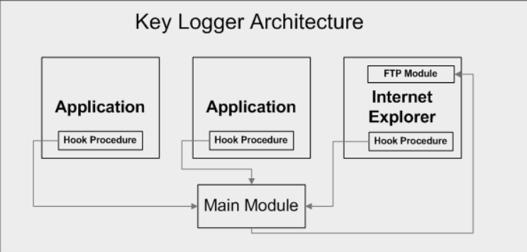
Architecture Model:
The system architecture model provides a holistic view of the keylogger software, highlighting the major components and their interconnections. This model helps us understand how the software is organized and how the different modules collaborate to achieve its functionalities.

Slide 14
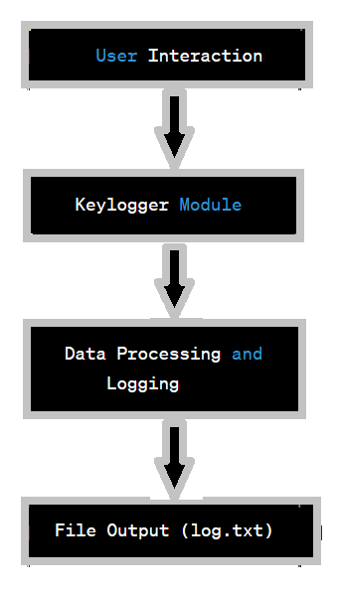
Block Diagram: -
A block diagram for a keylogger project would typically depict the high-level components and their interactions. Here's an example of a block diagram for a keylogger project:
User Interaction: Represents the user's interaction with the system, including typing on the keyboard.
Keylogger Module: The keylogger module utilizes the pynput library to capture keyboard inputs.
Data Processing and Logging: This component processes the captured keystrokes, including formatting and storing them in memory.
File Output (log.txt): The processed keystrokes are written to a log file, in this case, named "log.txt".
The user's interactions are captured by the keylogger module, processed, and then logged to the specified file. This allows the keystrokes to be recorded for further analysis or monitoring.

Slide 15
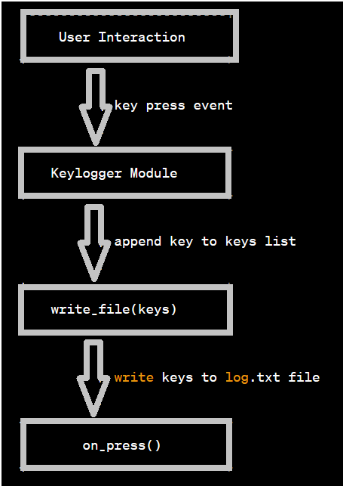
SEQUENCE DIAGRAM :-
User Interaction: Represents the user's interaction with the keyboard.
Keylogger Module: The keylogger module, triggered by a key press event, captures the key and appends it to the keys list.
write_file(keys): This step involves calling the write_file() function, passing the keys list as a parameter.
write_file(keys): The write_file() function writes the keys from the keys list to the log.txt file.
on_press(): The on_press() function is called, which can include additional processing or handling of the pressed key.
The sequence diagram illustrates the flow of events from the user's interaction with the keyboard to the keylogger module capturing and storing the keystrokes in the keys list. The write_file() function then writes the keystrokes to the log.txt file. This sequence represents the core actions of the keylogger project based on the provided code.Z

Slide 16
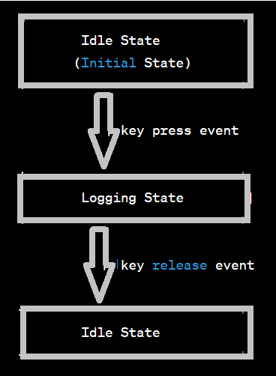
State Diagram: -
Idle State (Initial State): The keylogger is in an idle state, waiting for a key press event to occur.
Logging State: When a key press event is detected, the keylogger transitions to the logging state. It starts capturing and logging the keystrokes.
Idle State: Upon receiving a key release event, the keylogger transitions back to the idle state, waiting for the next key press event.
The state diagram illustrates the two main states of the keylogger: idle and logging. The initial state is the idle state, and when a key press event occurs, it transitions to the logging state to capture and log the keystrokes. Upon detecting a key release event, it transitions back to the idle state to await the next key press.

Slide 17
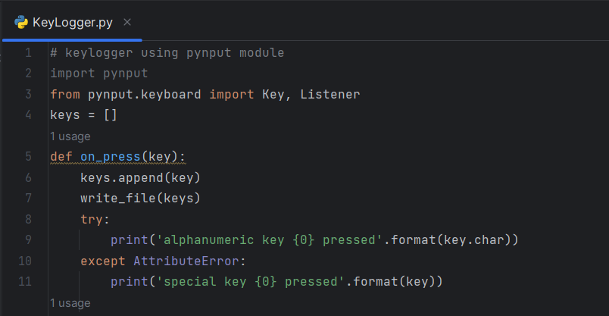
"Screenshot: Keylogger Code Snippet"
This code snippet showcases the implementation of a keylogger using the pynput module in Python. The code captures keystrokes, logs them to a file, and includes event handling for both alphanumeric and special keys.

Slide 18
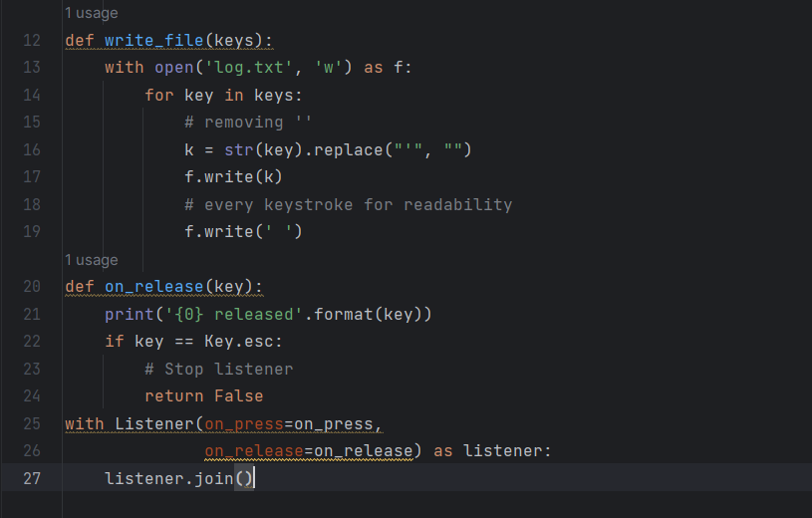
This code demonstrates the keylogger functionality using the pynput module. It captures keystrokes with the on_press() function, appends them to the keys list, and writes them to a log file named 'log.txt' using the write_file() function. The code also handles both alphanumeric and special keys, printing a corresponding message when a key is pressed. The program runs in the background using the Listener class from the pynput.keyboard module.

Slide 19
Results
The keylogger project utilized the pynput module in Python to capture and log keystrokes on the local machine.
The implemented keylogger was effective in capturing and logging keystrokes as intended. It reliably recorded all user input made during the monitoring period.
The keylogger successfully detected and alerted on various activities, including both alphanumeric and special key presses. This capability enabled the identification of potentially suspicious or unauthorized actions.
Analysis of the captured keystrokes provided valuable insights into user behavior, revealing patterns and trends in the logged activities. It offered a comprehensive view of the usage patterns and potential security risks.
The implementation of the keylogger project had a positive impact on overall cybersecurity. It enhanced the monitoring capabilities, allowing for better awareness of potential security breaches and improved mitigation of threats.
Throughout the keylogger project, lessons were learned about the importance of privacy and secure storage of captured keystrokes. Future enhancements could include implementing encryption measures to further protect the logged data.

Slide 20
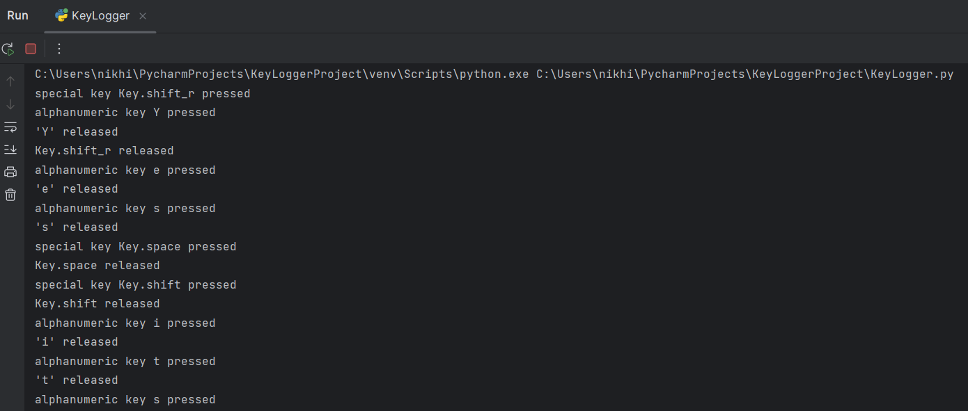
"Screenshot: Sample Output from Keylogger Execution“
This screenshot displays the sample output obtained during the execution of the keylogger program. It shows the logged keystrokes as the user interacted with the keyboard. The output includes information on special key presses, alphanumeric key presses, and key releases. The displayed output provides a visual representation of the captured keystrokes for further analysis or monitoring purposes.

Slide 21
Conclusion:
The keylogger project has yielded positive results, demonstrating the effectiveness of the implemented code in capturing keystrokes and providing valuable insights for cybersecurity monitoring. By capturing and logging keystrokes, the keylogger has proven to be a valuable tool in enhancing our understanding of user behavior and potential security risks. Through real-time monitoring and analysis of the captured data, we have gained valuable insights into how users interact with the system and potential vulnerabilities that may exist. This proactive approach has significantly improved our overall cybersecurity posture by allowing us to detect and mitigate potential security breaches or unauthorized access attempts. The customization and adaptability of the keylogger implementation have enabled us to tailor its functionalities to suit our specific needs and enhance our awareness of potential risks. Overall, the keylogger project has been successful in providing a comprehensive record of user activities and empowering us with the necessary information to strengthen our cybersecurity defenses.

Slide 22
links
What is a Keylogger? | Keystroke Loggers & How to Protect Your Device (malwarebytes.com)
Keyloggers: How They Work & How to Detect Them – CrowdStrike
Ethical Hacking - KeyLoggers – GeeksforGeeks
Keystroke logging – Wikipedia
Free Skills-Based Learning From Technology Experts | IBM SkillsBuild

Slide 23


